Slide 1

INSIZE
Quality Innovation Service Value
Oil & Gas
Pipelines
INSIZE CO., LTD.
www.insize.com
V.1 05.2026

Slide 2


CONTENTS
01 Dimensional Measurement (Measuring Tools)
02 Dimensional Measurement (Measuring Instruments)
03 Component Analysis
04 Mechanical Testing
05 Flaw Detection Testing
06 Surface Inspection
07 Roughness Measurement
08 Hardness Testing
09 Metallographic Inspection
10 Coating/Plating Thickness Measurement
11 Reliability Testing
12 Working Condition Inspection

Slide 3

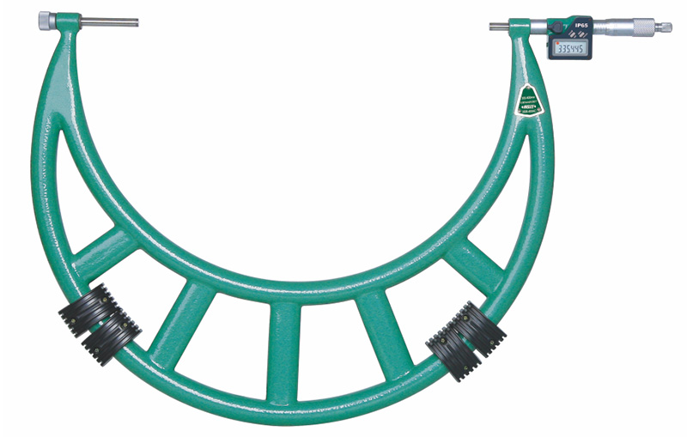
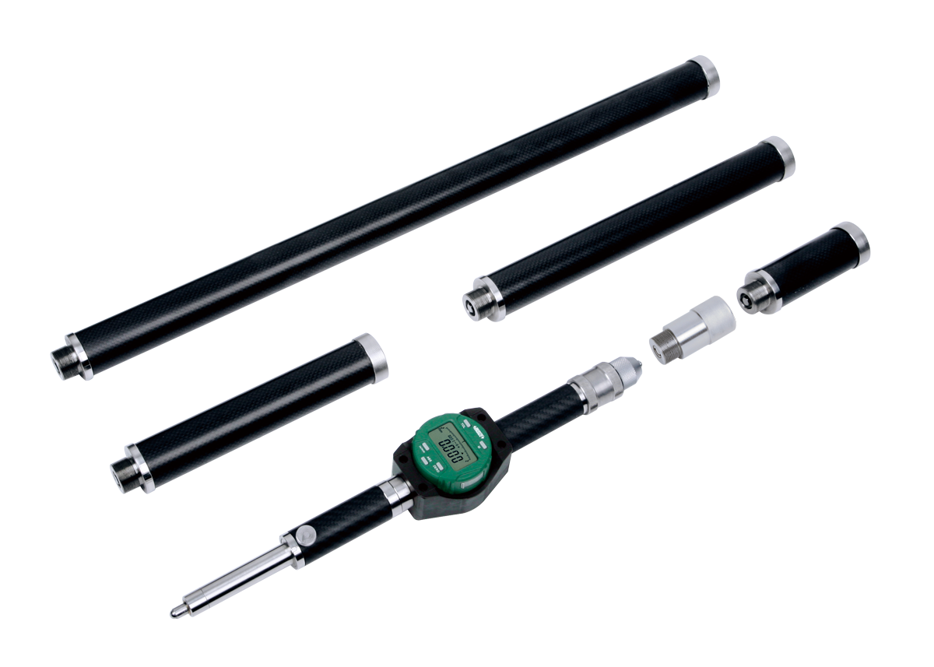
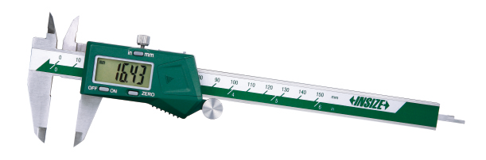
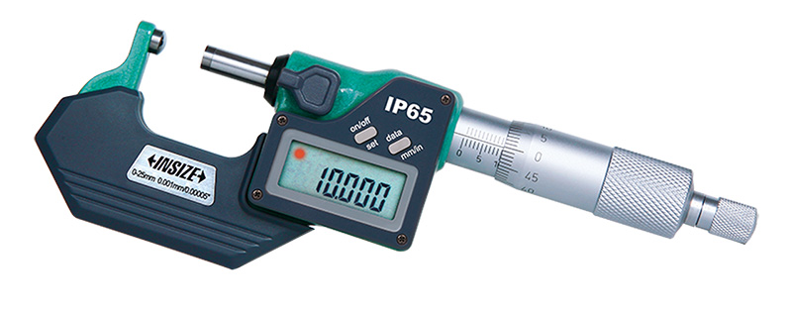
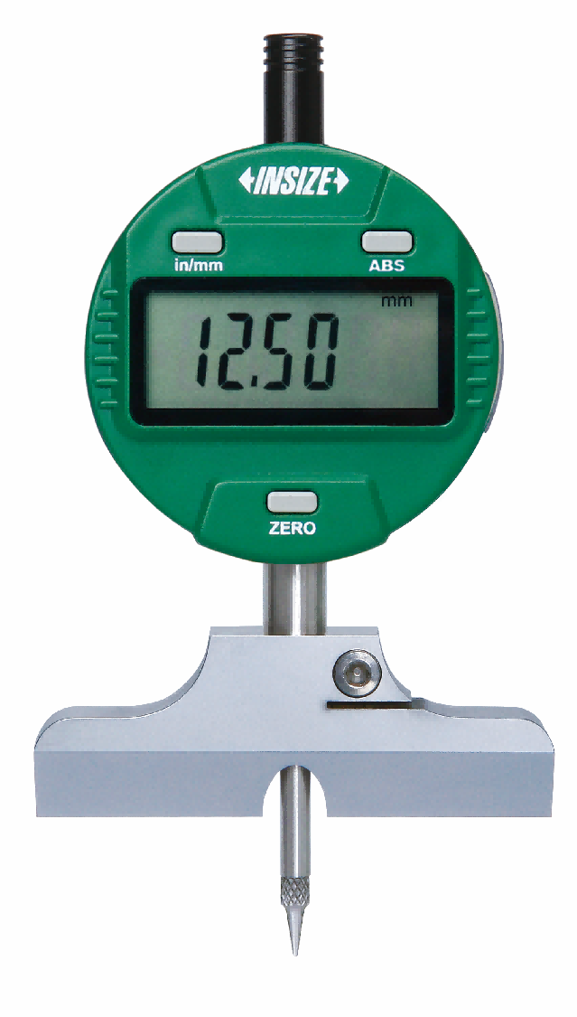
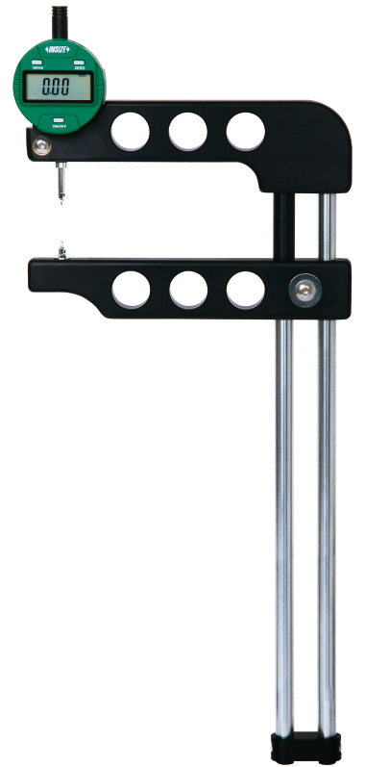
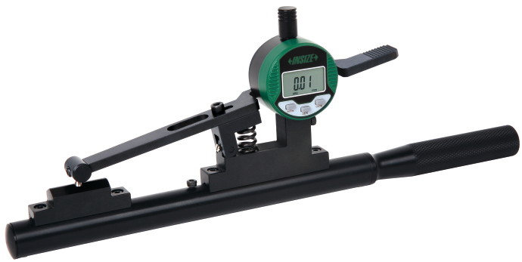
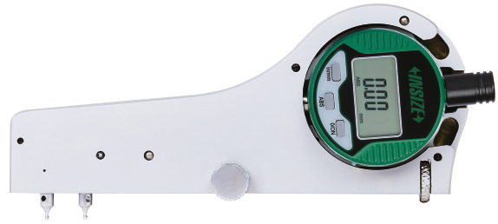
01
Dimensional Measurement (Measuring Tools P1)
Digital Calipers
Digital Micrometers
Digital Outside Micrometers
Carbon Fiber Bore Gauges
Digital Depth Gauges
Digital Thread Pitch
Measuring Instruments
Digital Thread Taper
Measuring Instruments
Digital Thread Height
Measuring Instruments

Slide 4
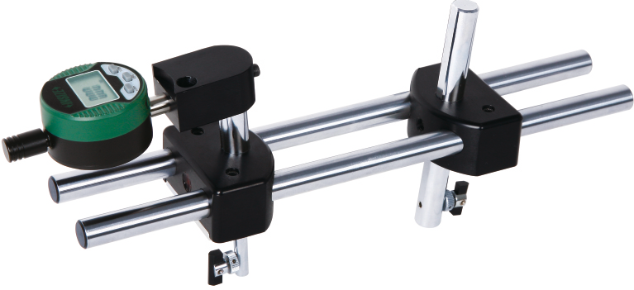
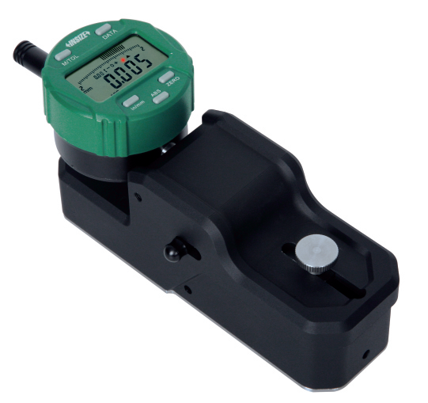
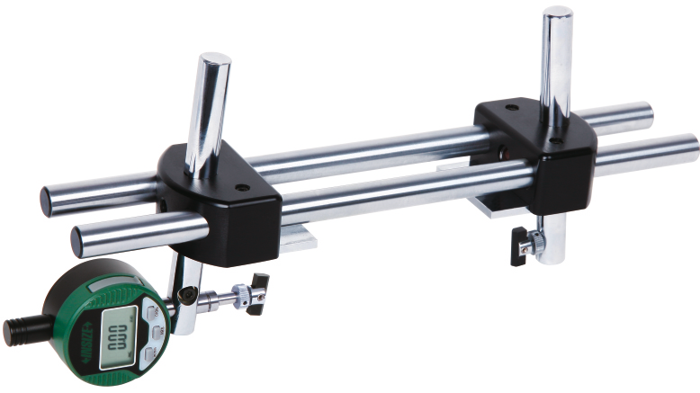
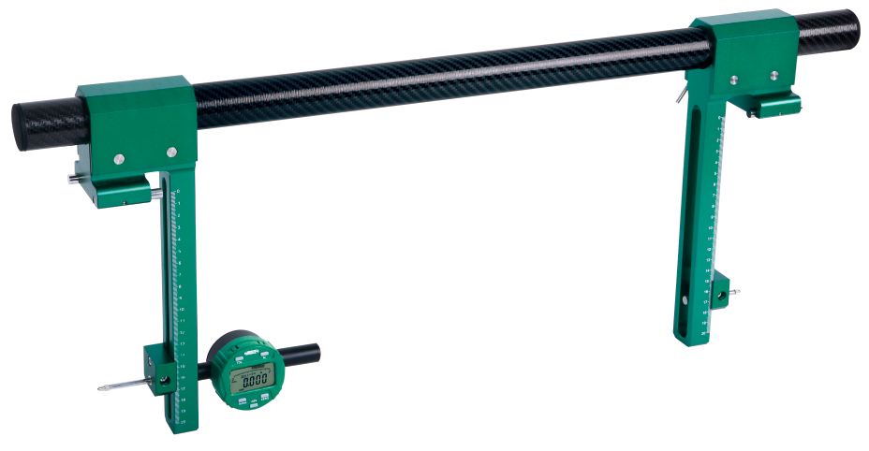
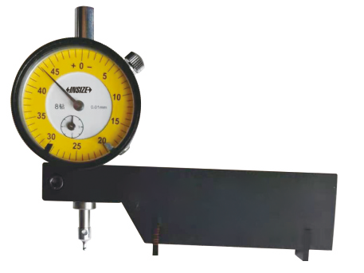
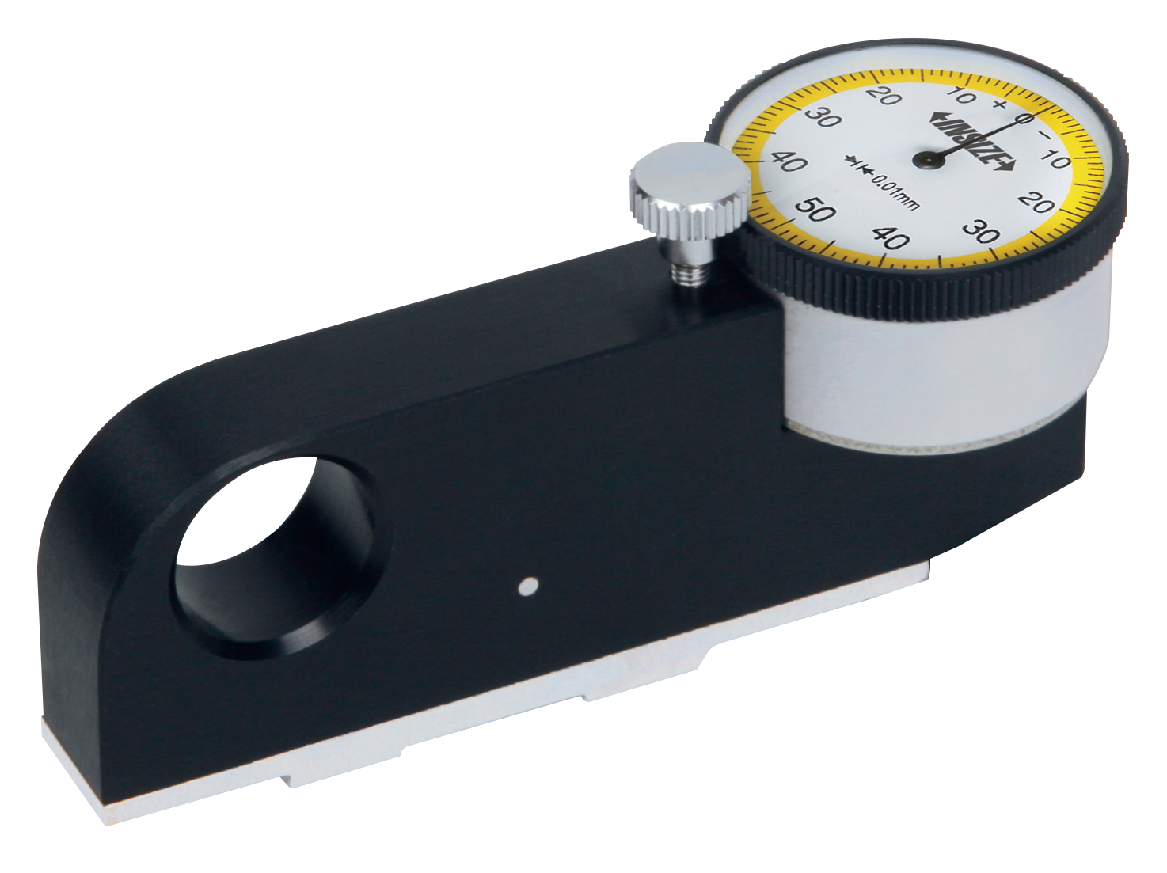
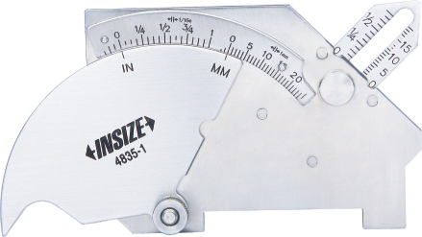
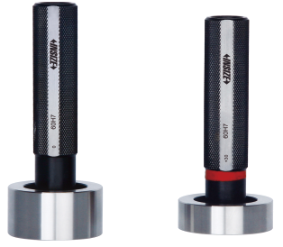
01
Dimensional Measurement (Measuring Tools P2)
Digital Thread Crest Diameter Measuring Instruments
Digital Groove Width
Measuring Instruments
Digital Groove Diameter Measuring Instruments
Carbon Fiber Comparison Gauges
数显半径规
Buttress Thread Run-Out Gauges
Buttress Thread Tooth Thickness Gauges
Welding Gauges
Plug Gauges
键槽量具

Slide 5
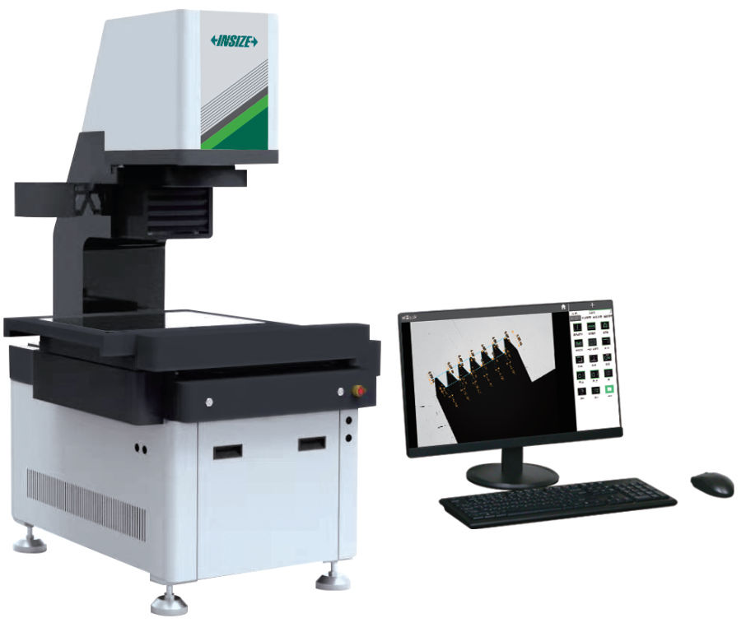
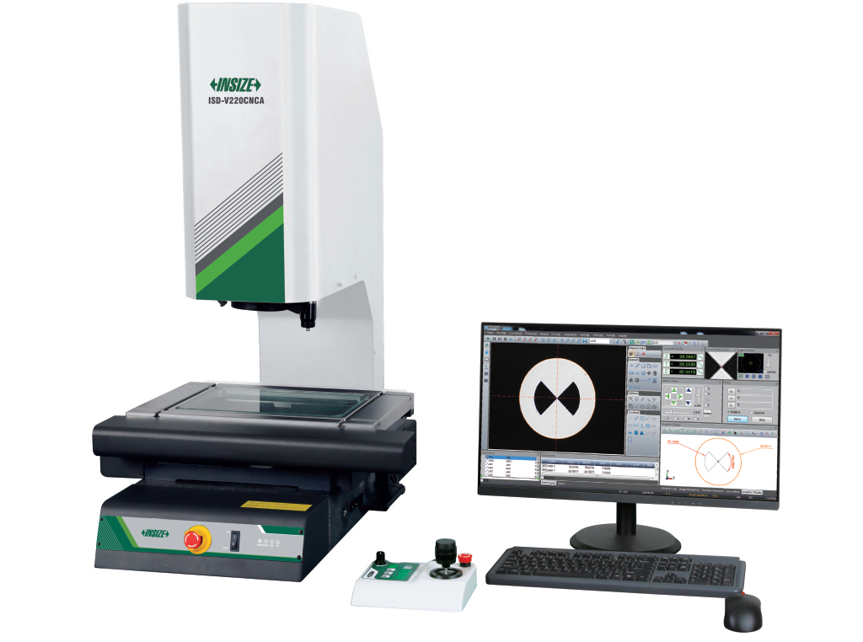
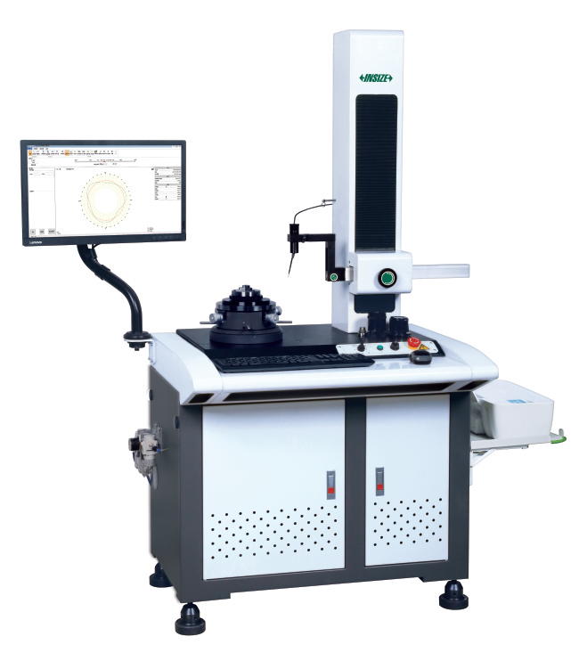
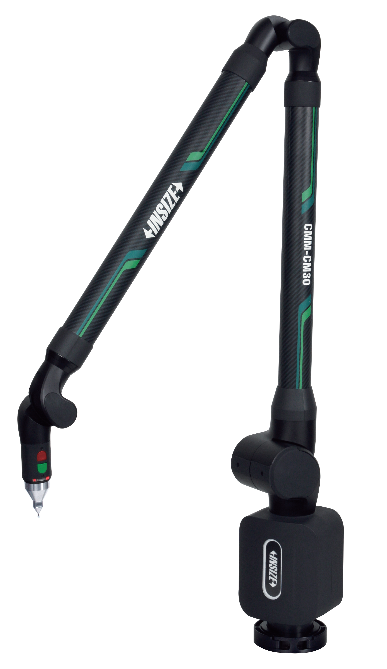
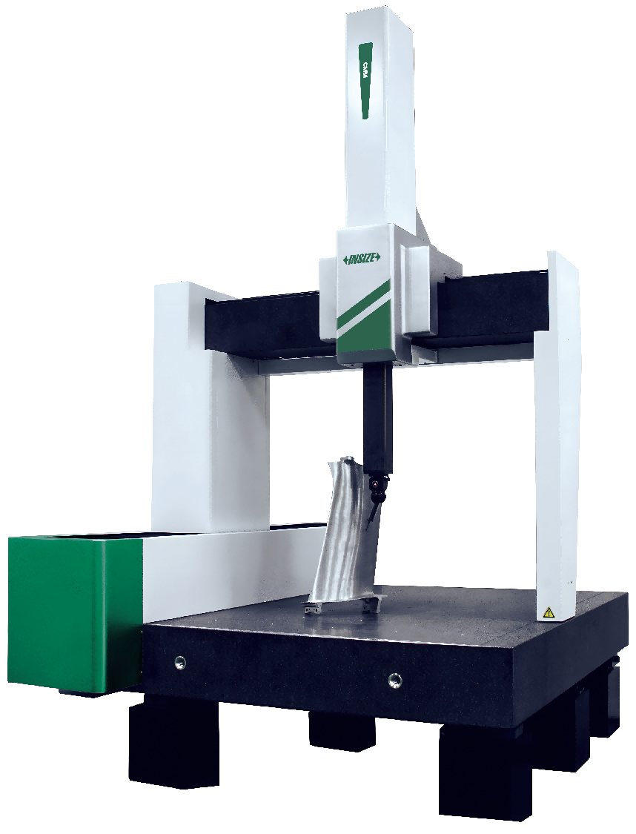
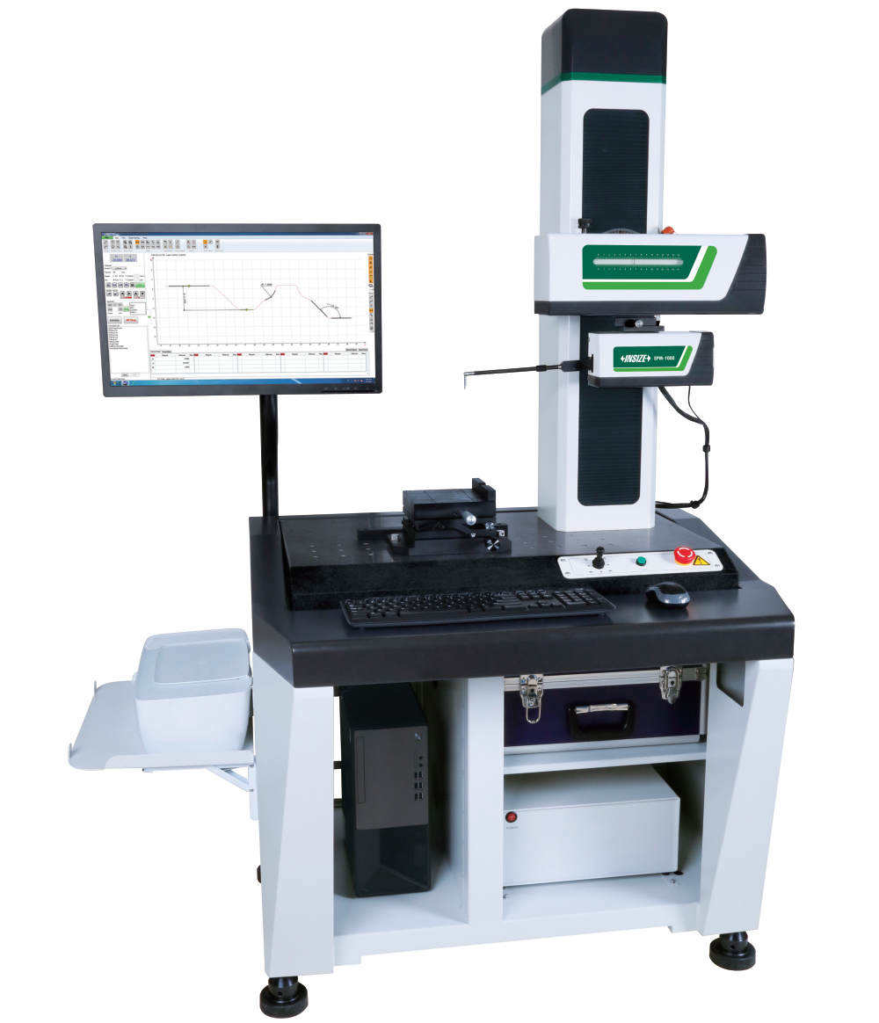
02
Dimensional Measurement (Measuring Instruments P1)
Roundness Measuring
Machines
Quick Measurement Systems
CNC Vision Measuring Systems
Coordinate Measuring Machines
Surface Profile Measuring Machines
Measuring Arms

Slide 6
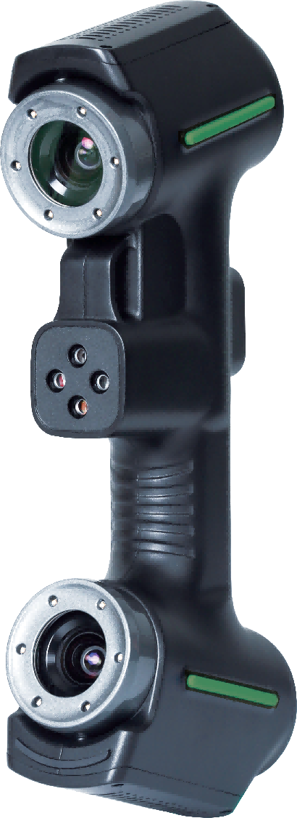
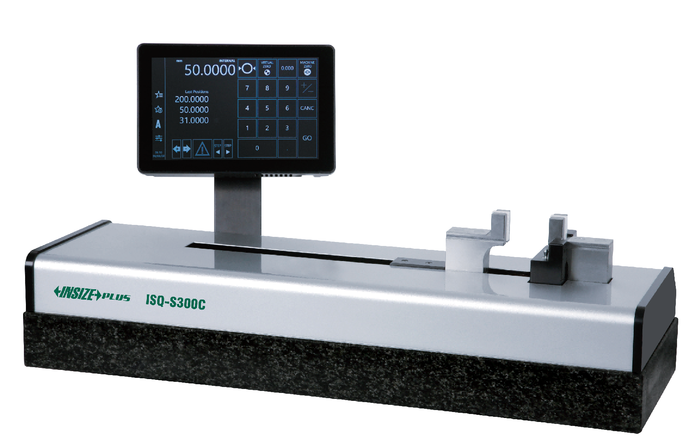
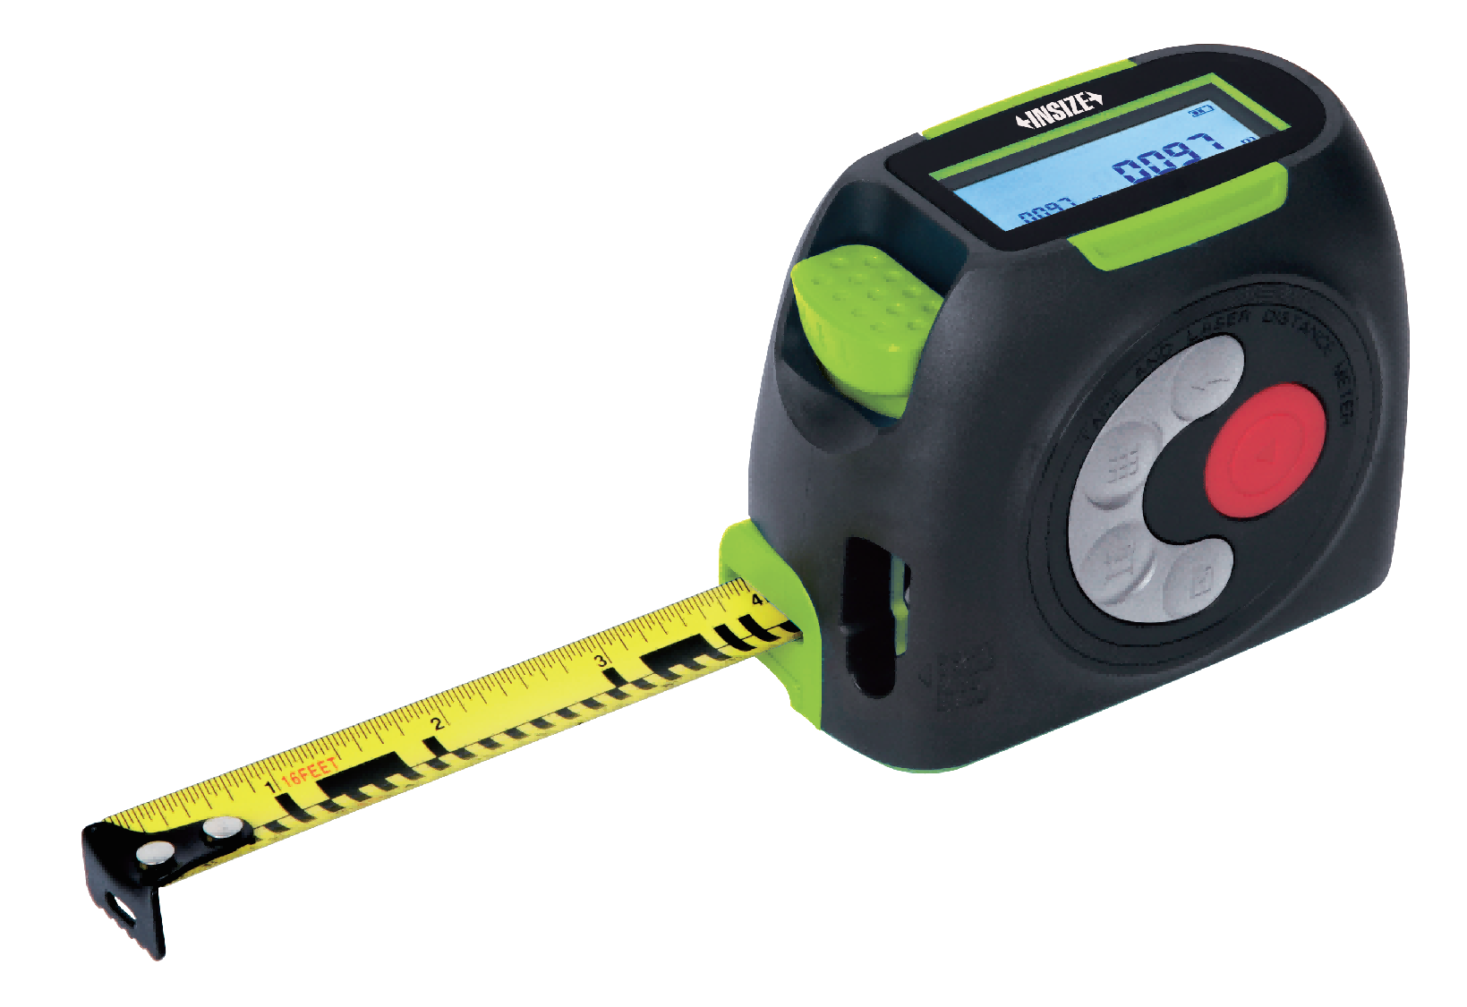
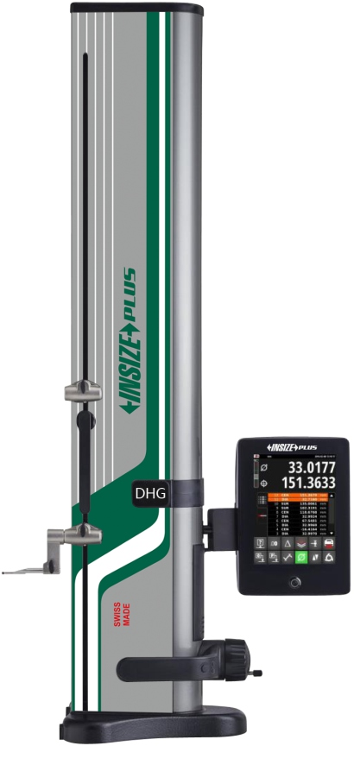
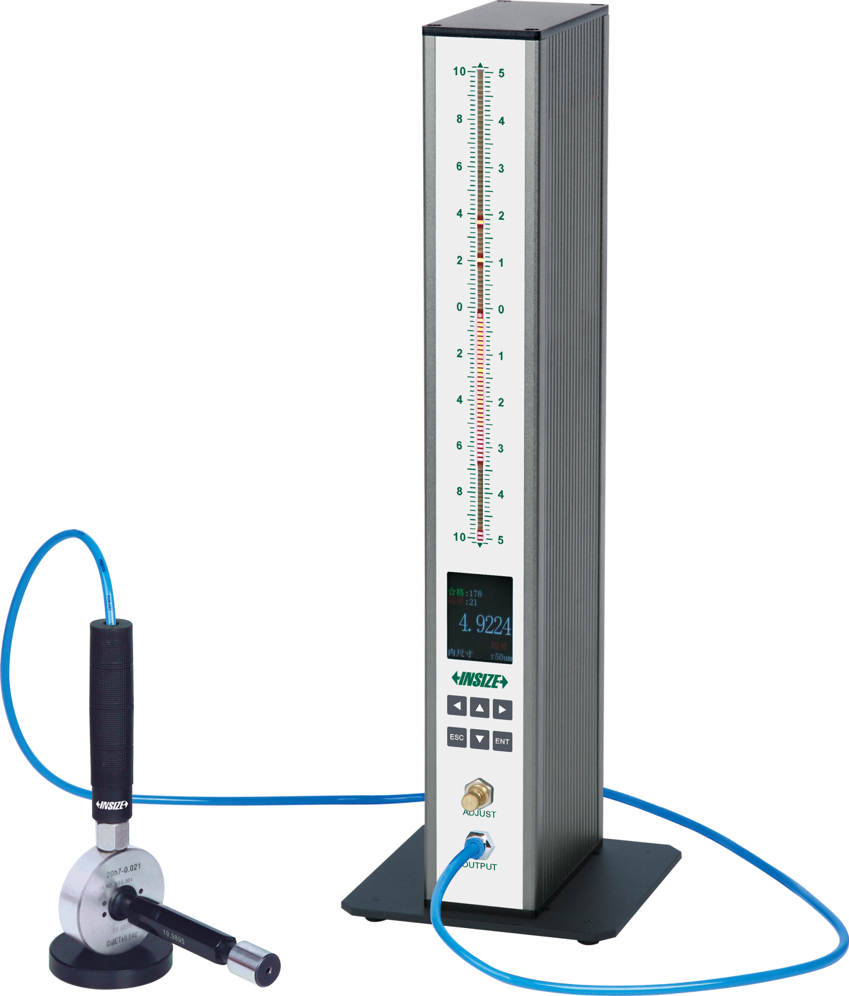
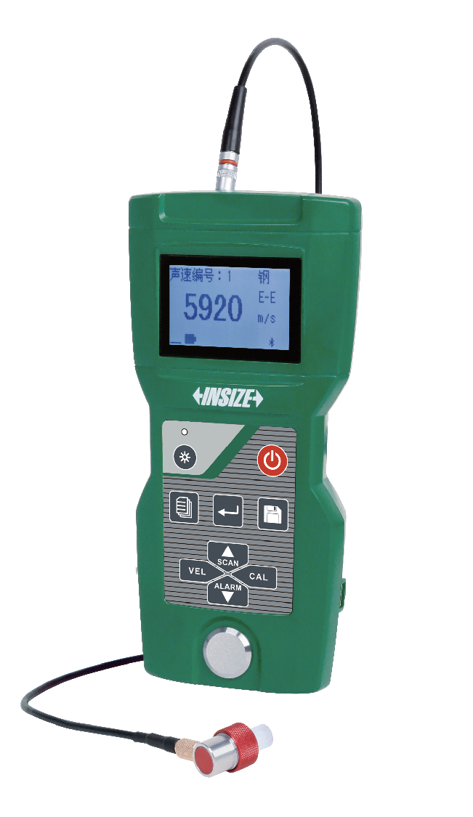
02
Dimensional Measurement (Measuring Instruments P2)
Wireless Digital Measuring Tapes
+ Laser Distance Meters
Handheld 3D Scanners
Length Presetters
Height Gauges
Air Gauges And Displays
Ultrasonic Thickness Gauges

Slide 7
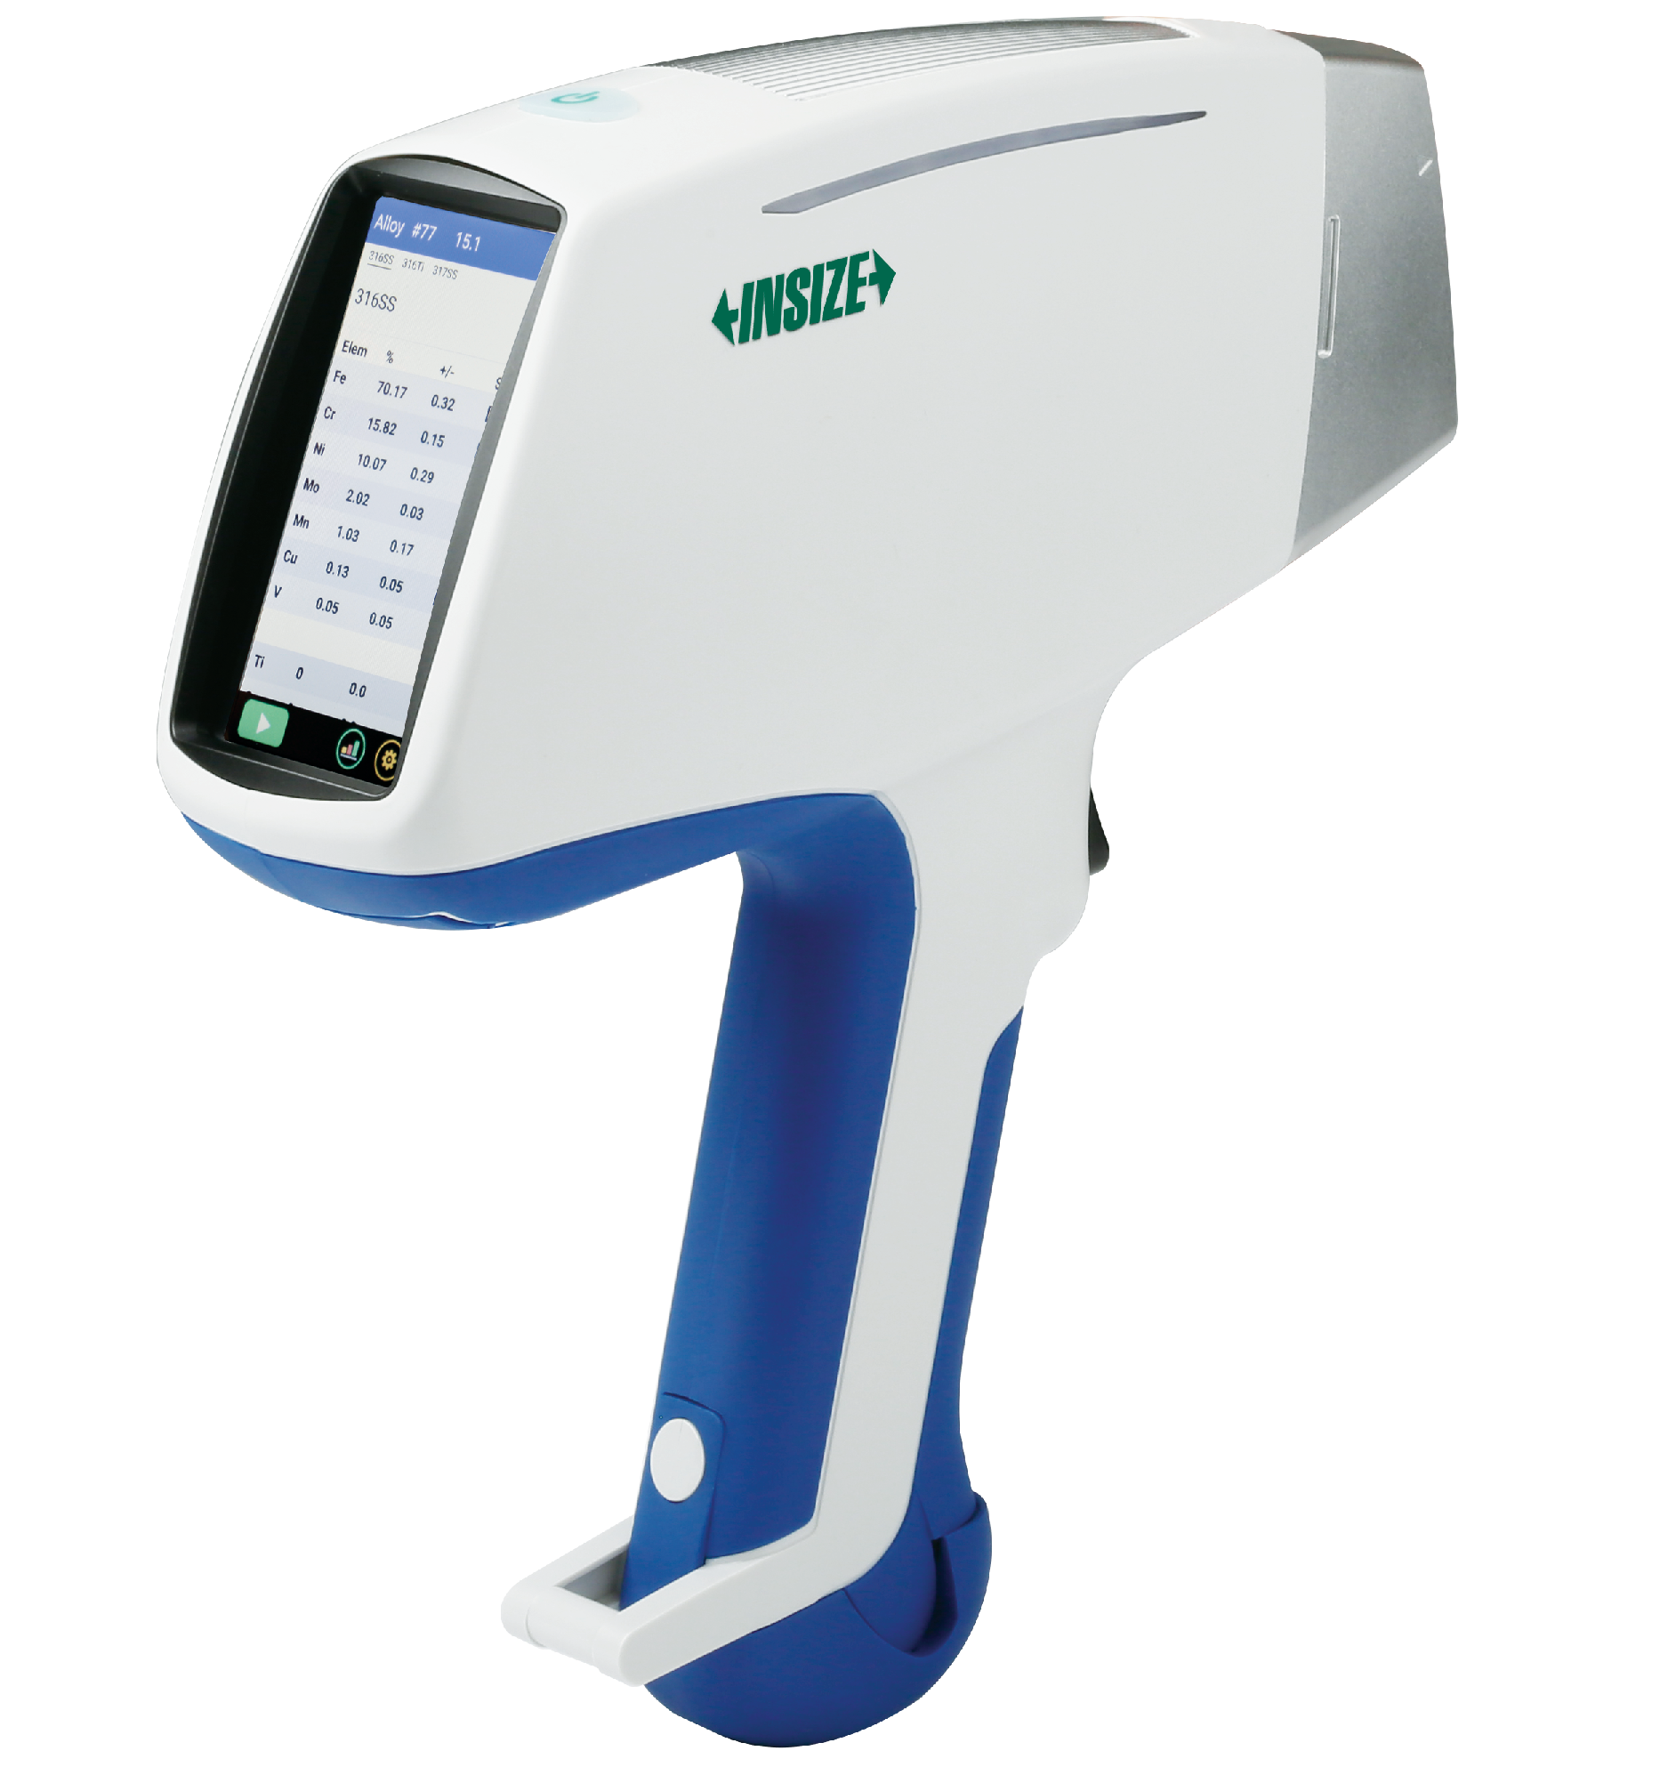
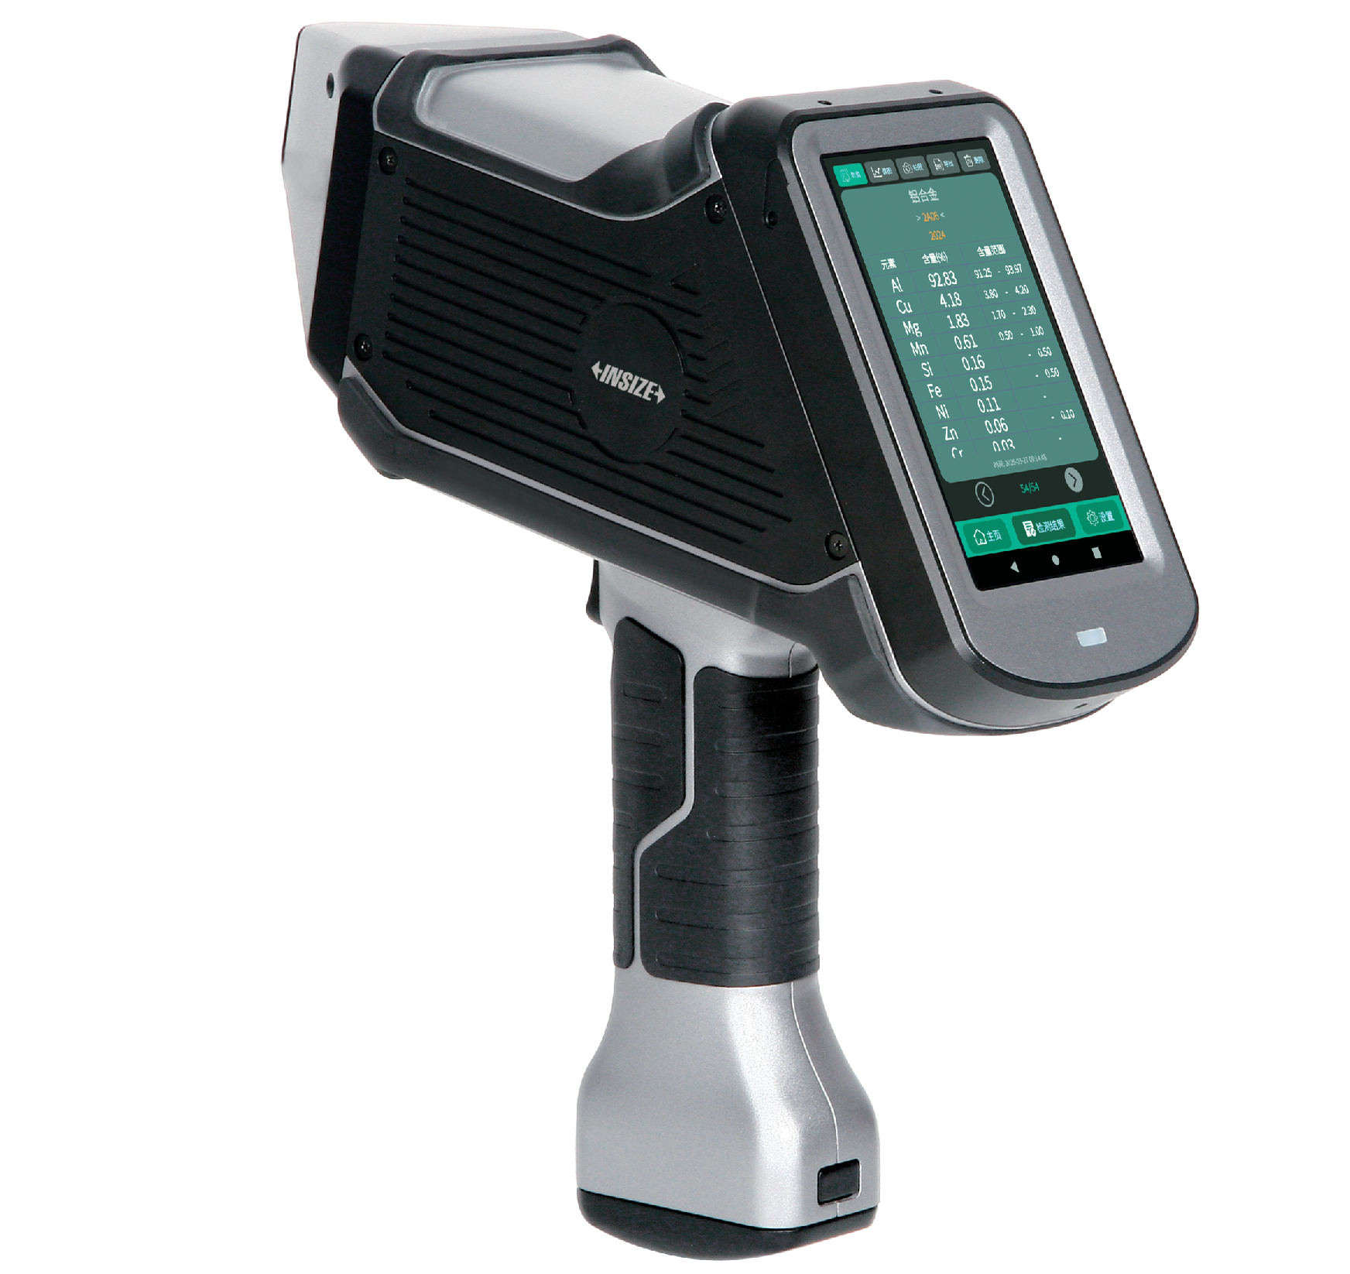
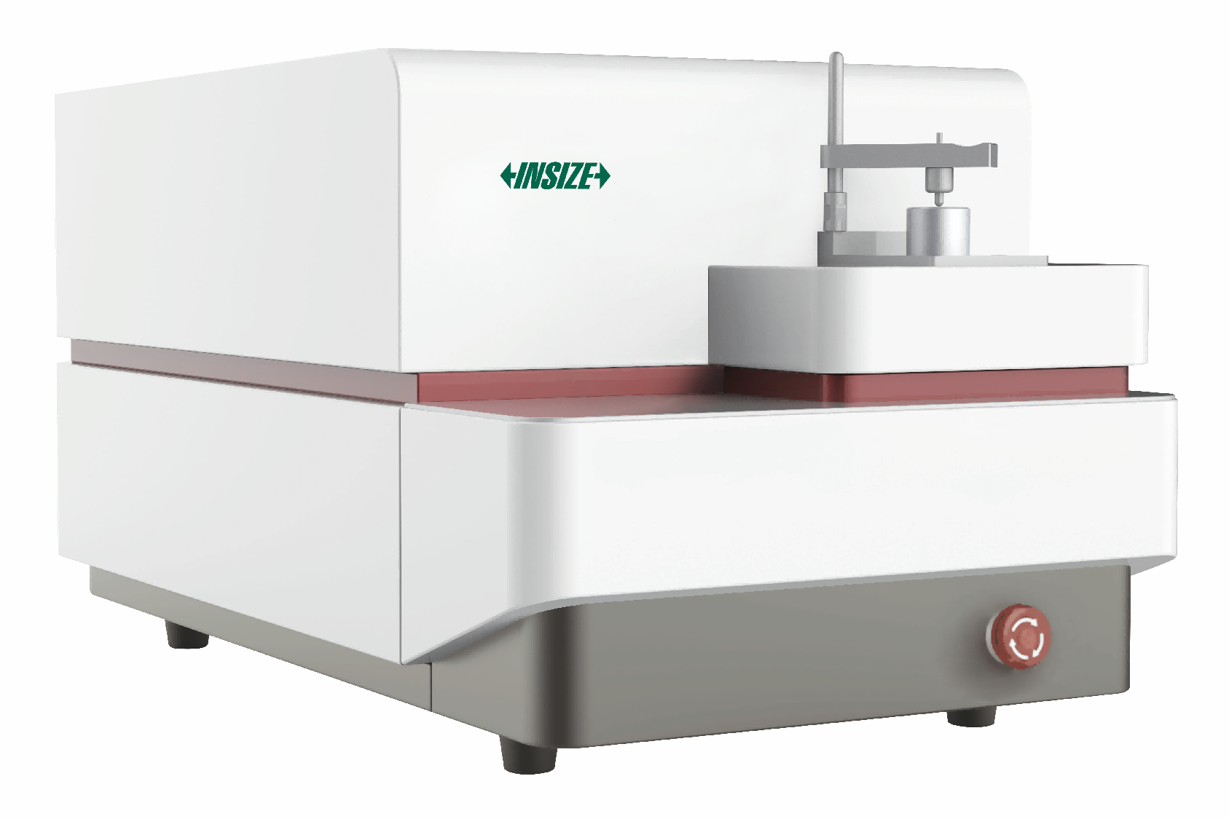
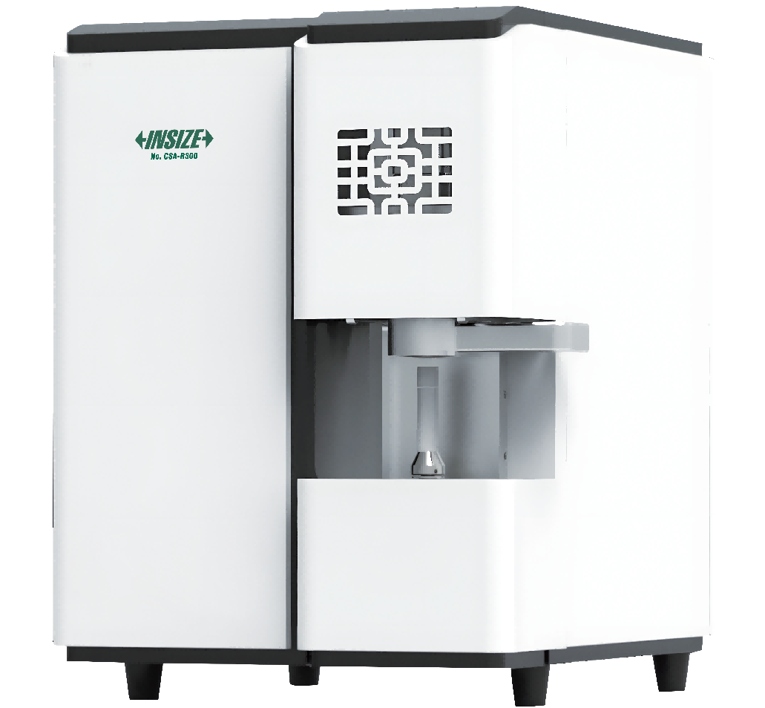
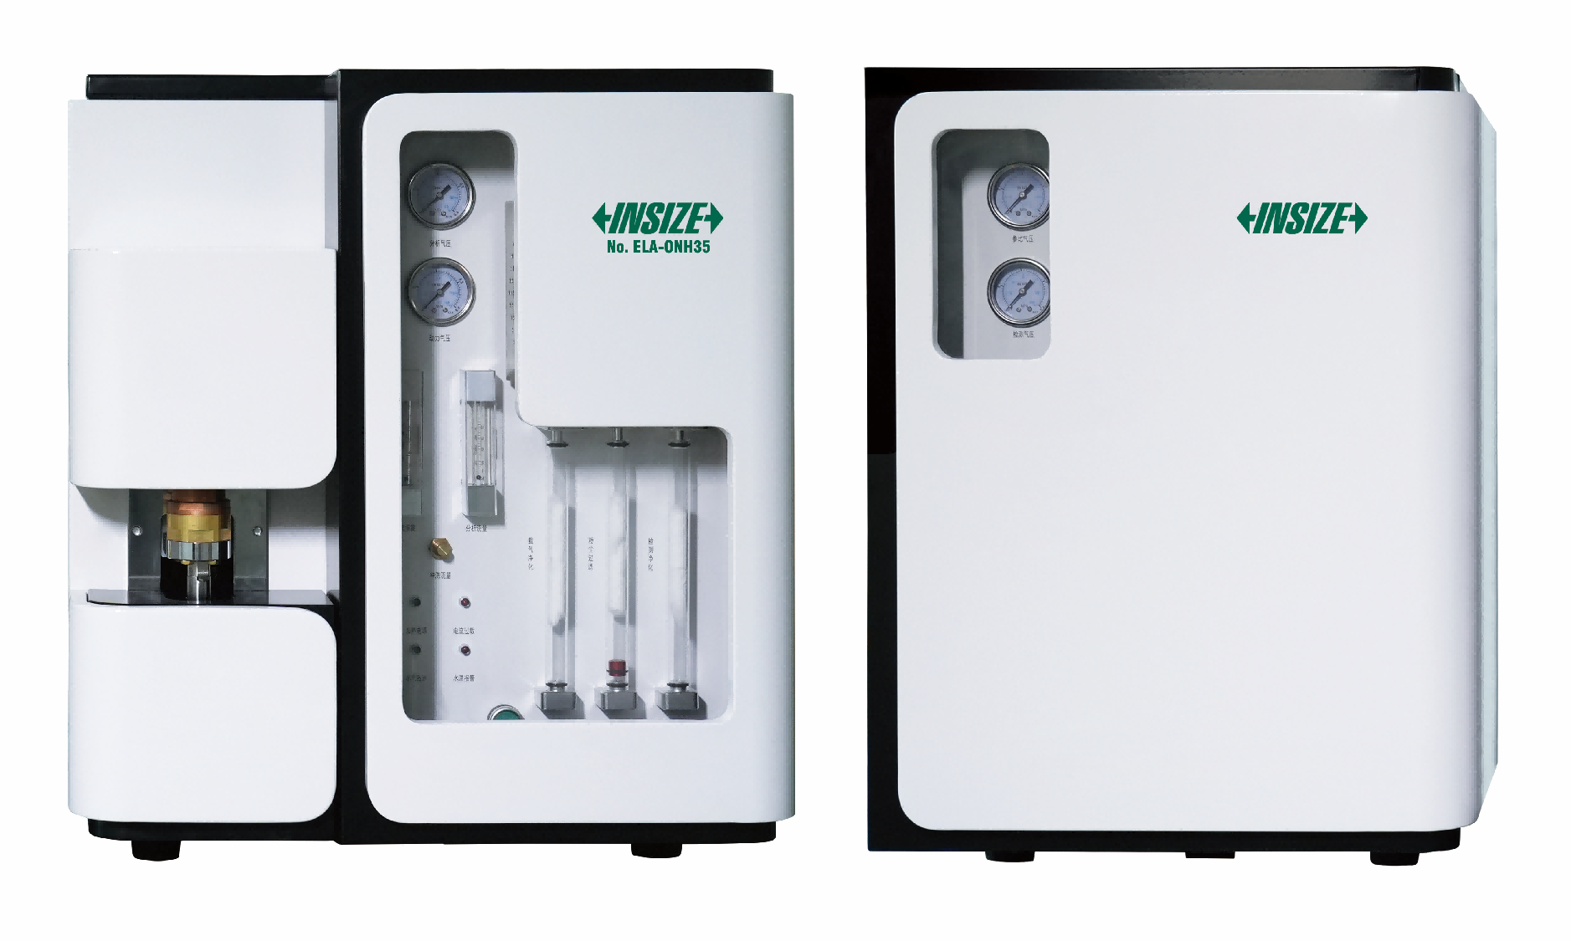
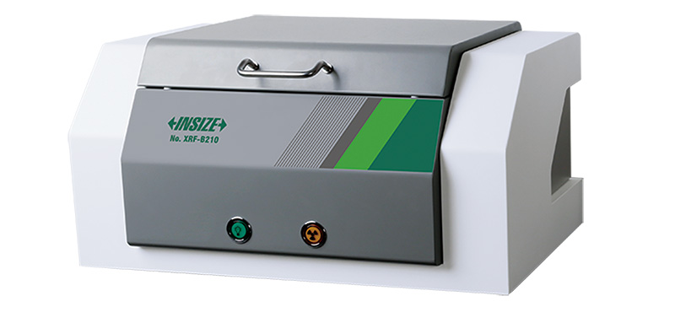
03
Component Analysis
Spark Direct Reading Spectrometers
Handheld XRF Alloy Analyzers
Handheld Libs Spectrometers
Oxygen/Nitrogen/Hydrogen Analyzers
RoHS Analyzers
Carbon And Sulfur Analyzers

Slide 8
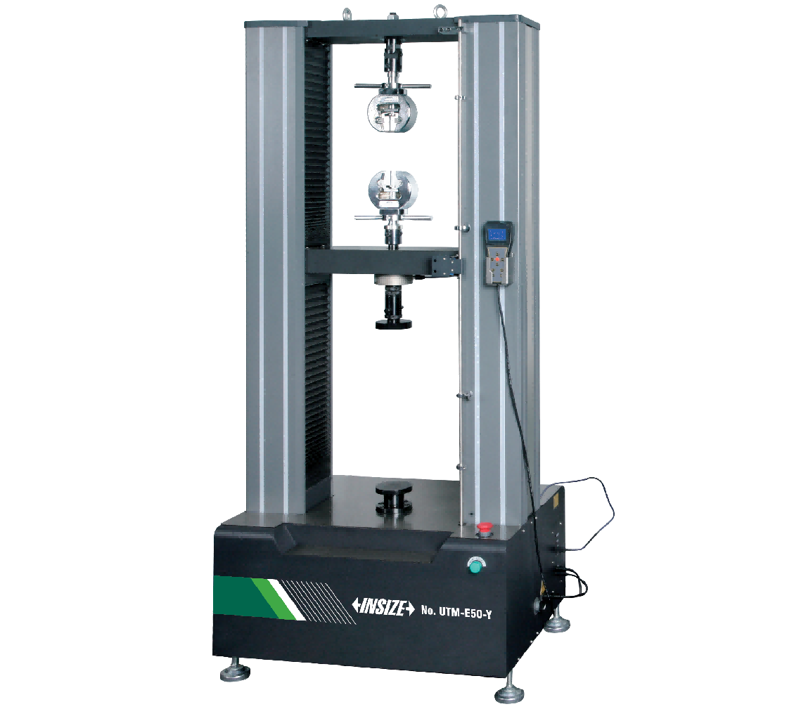
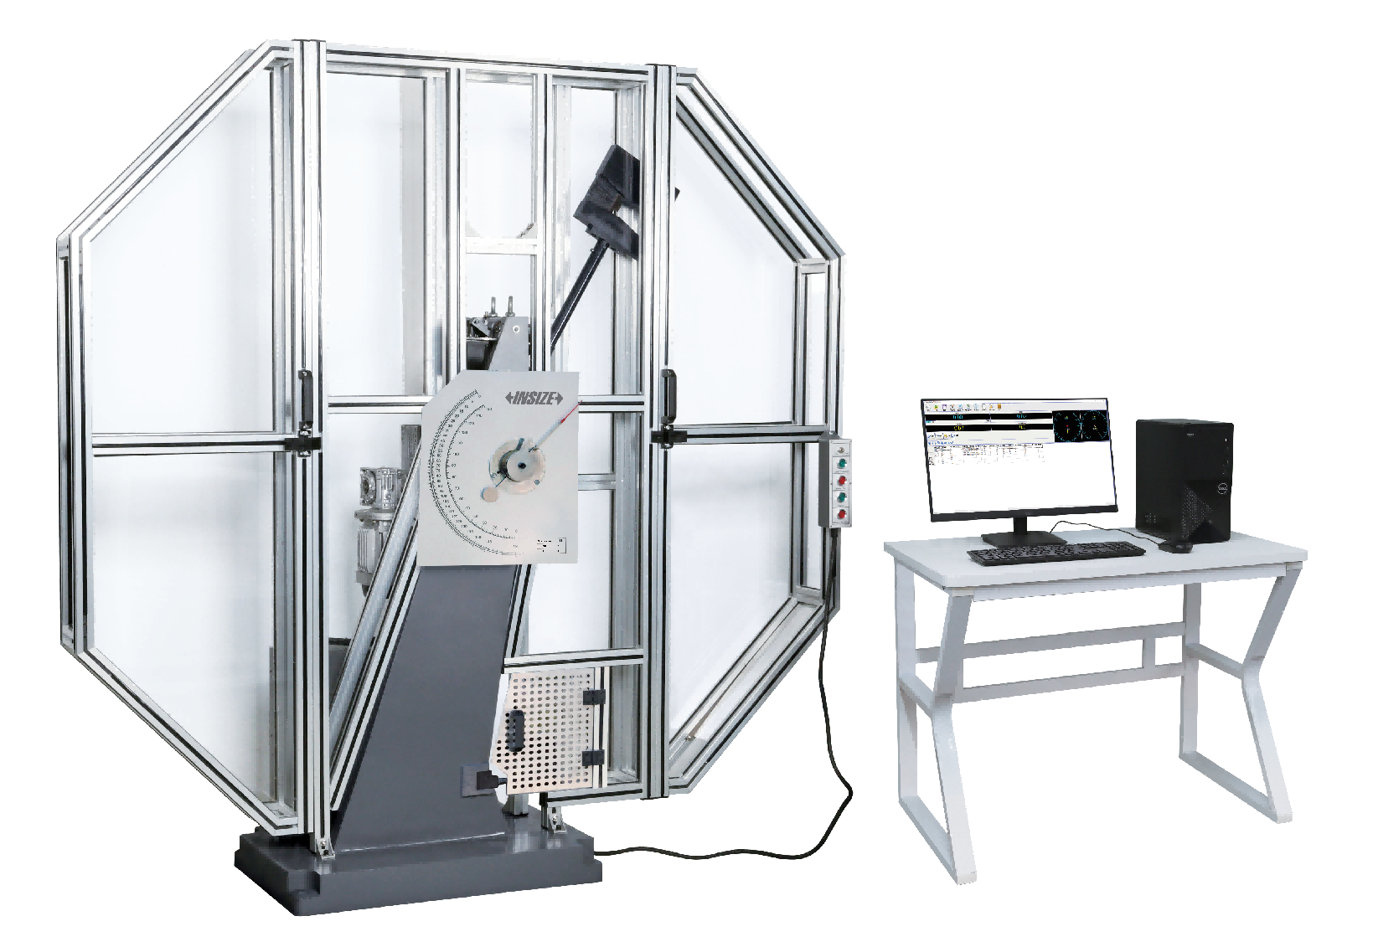
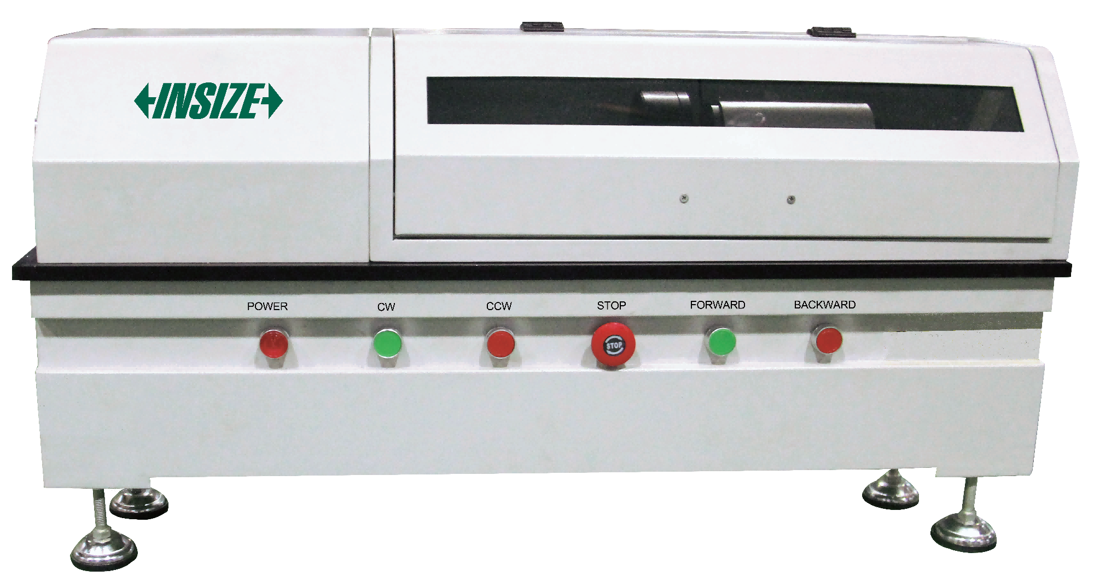
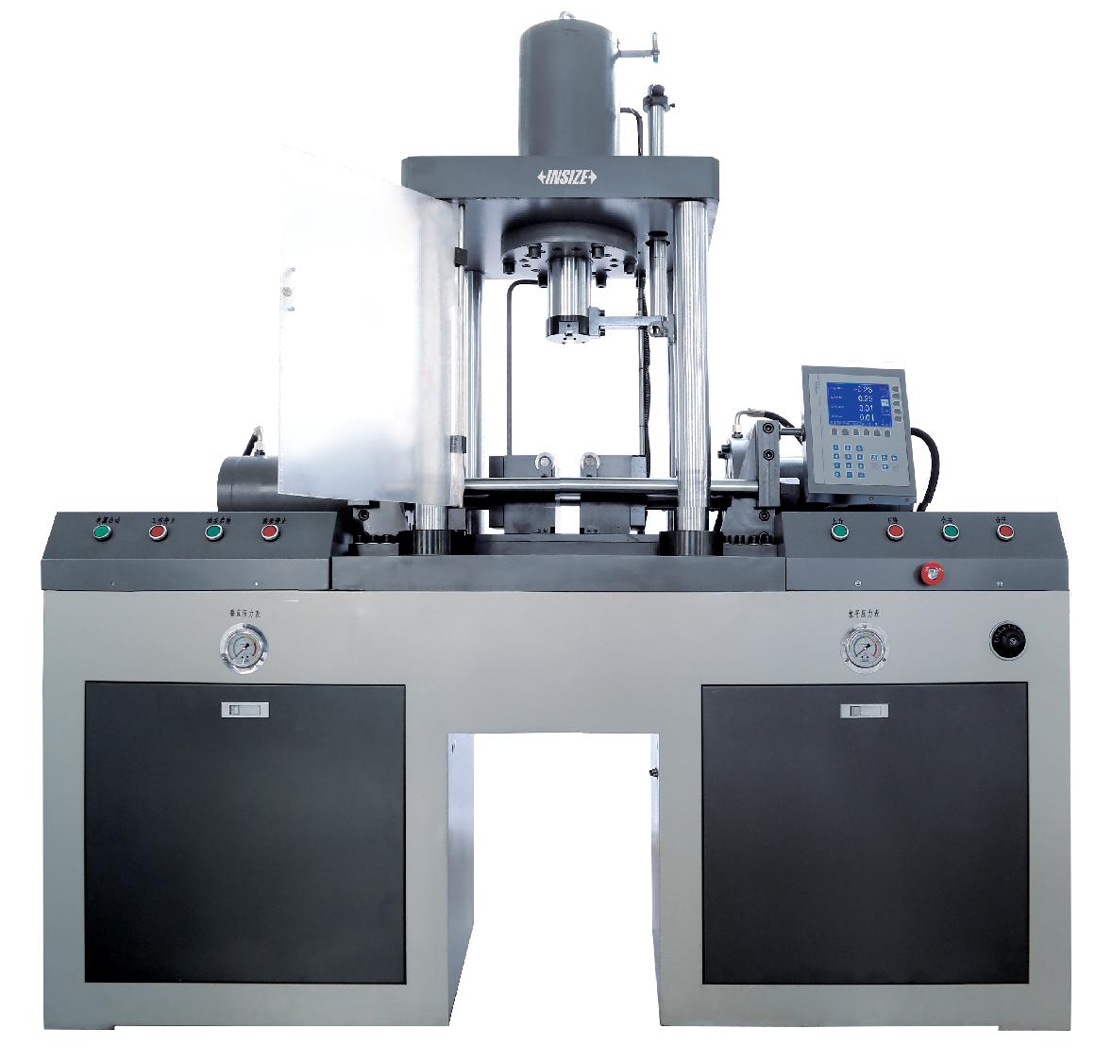
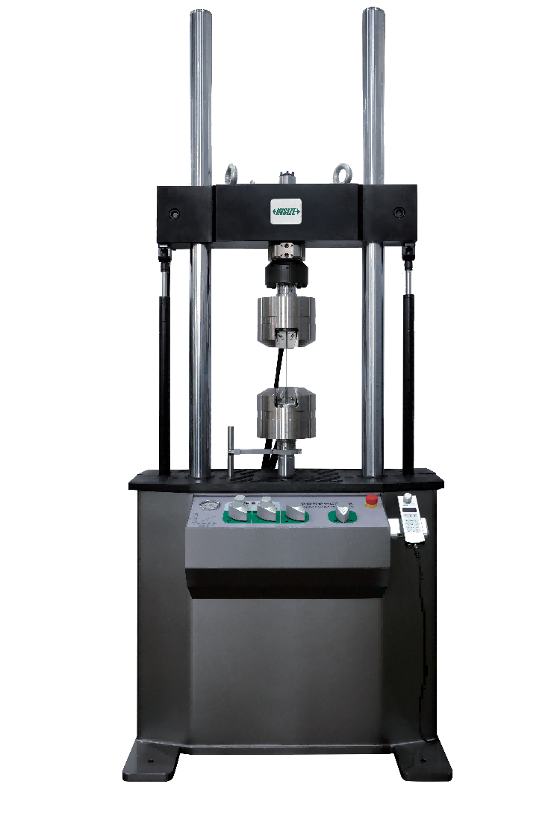
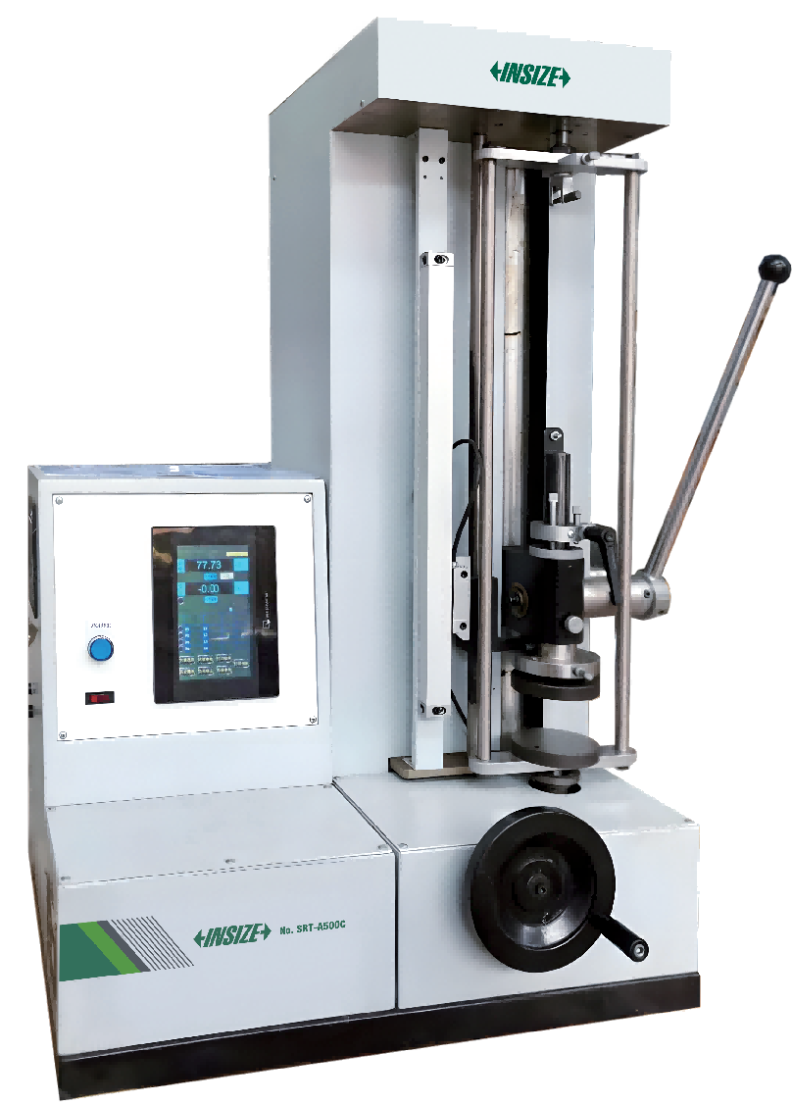
04
Mechanical Testing
Electronic Universal Testing Machines
Electronic Torsion Testing Machines
Impact Testing Machines
Vertical Bending Testing Machines
Servohydraulic Fatigue Testing Machines
Manual Spring Testing Machines

Slide 9
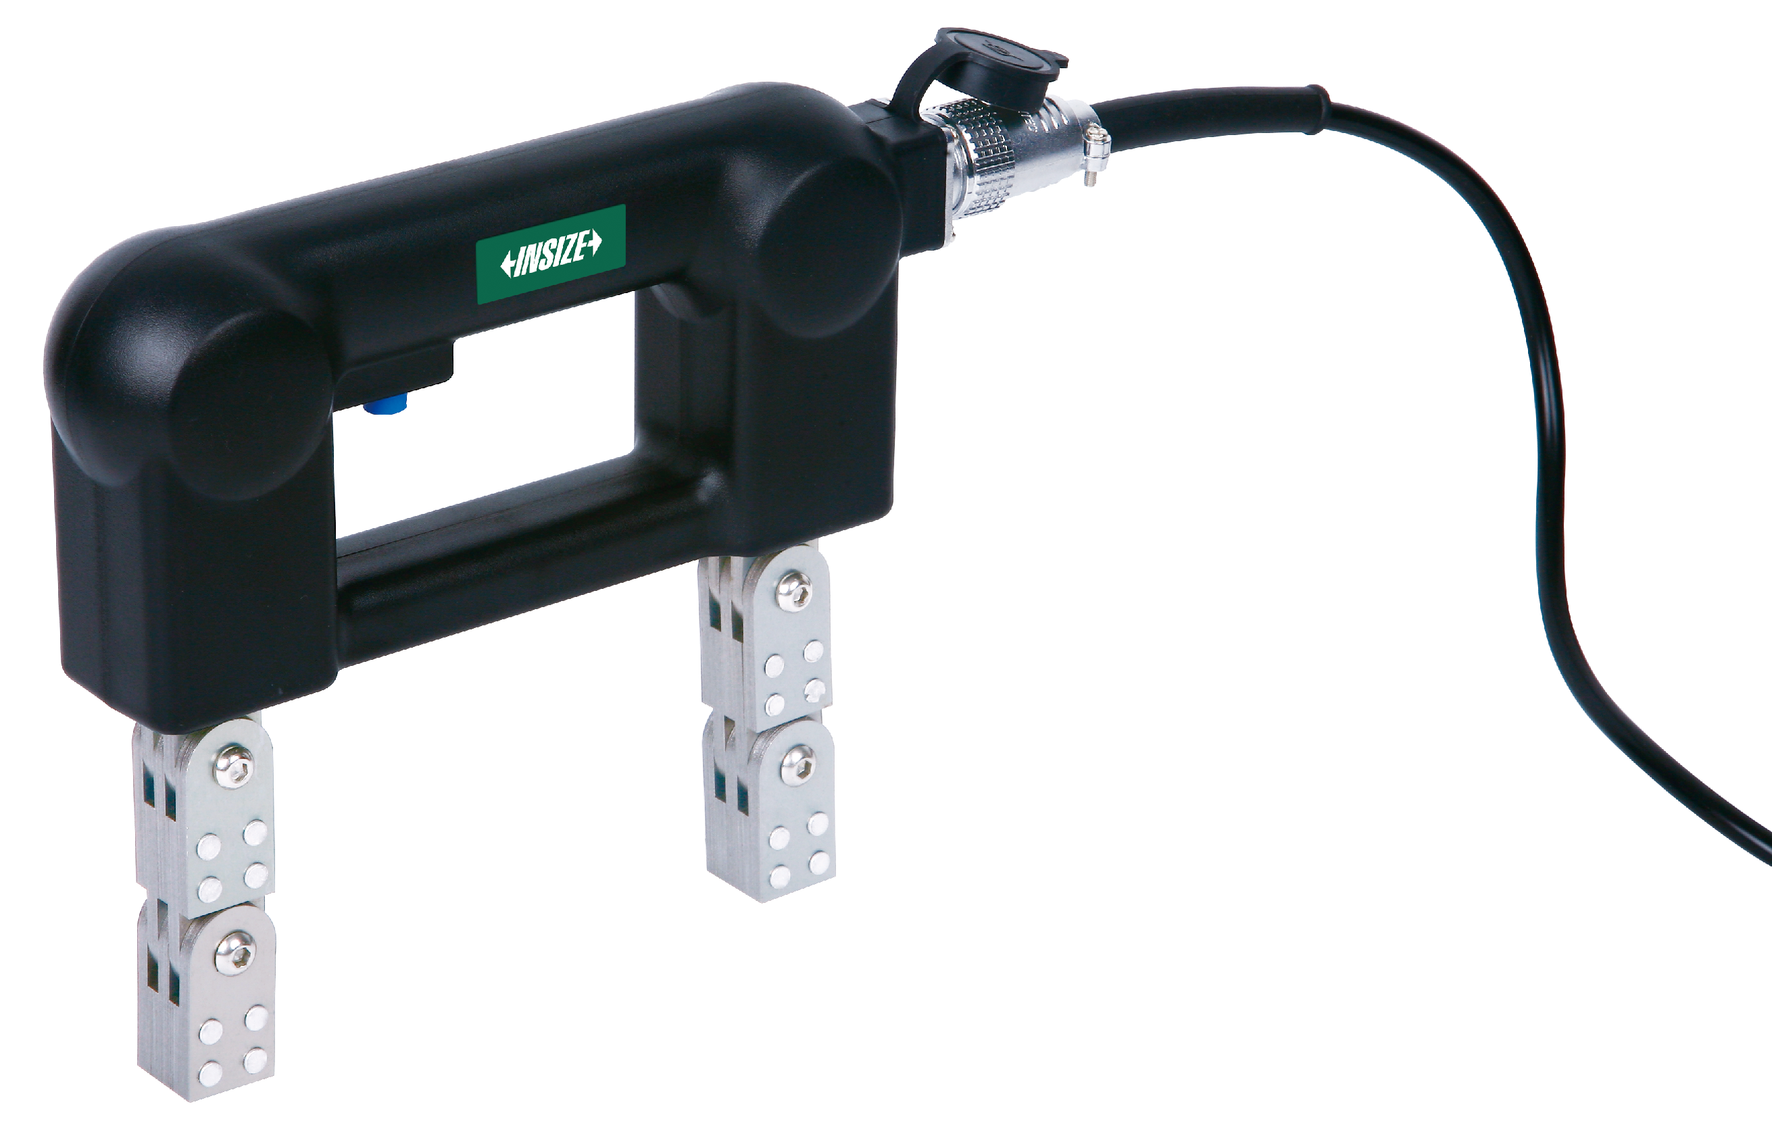
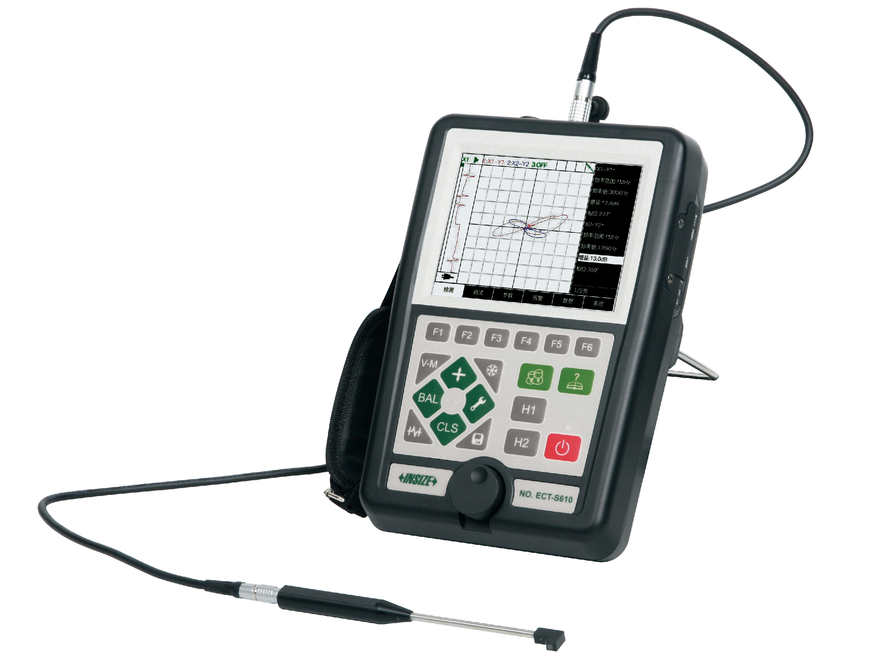
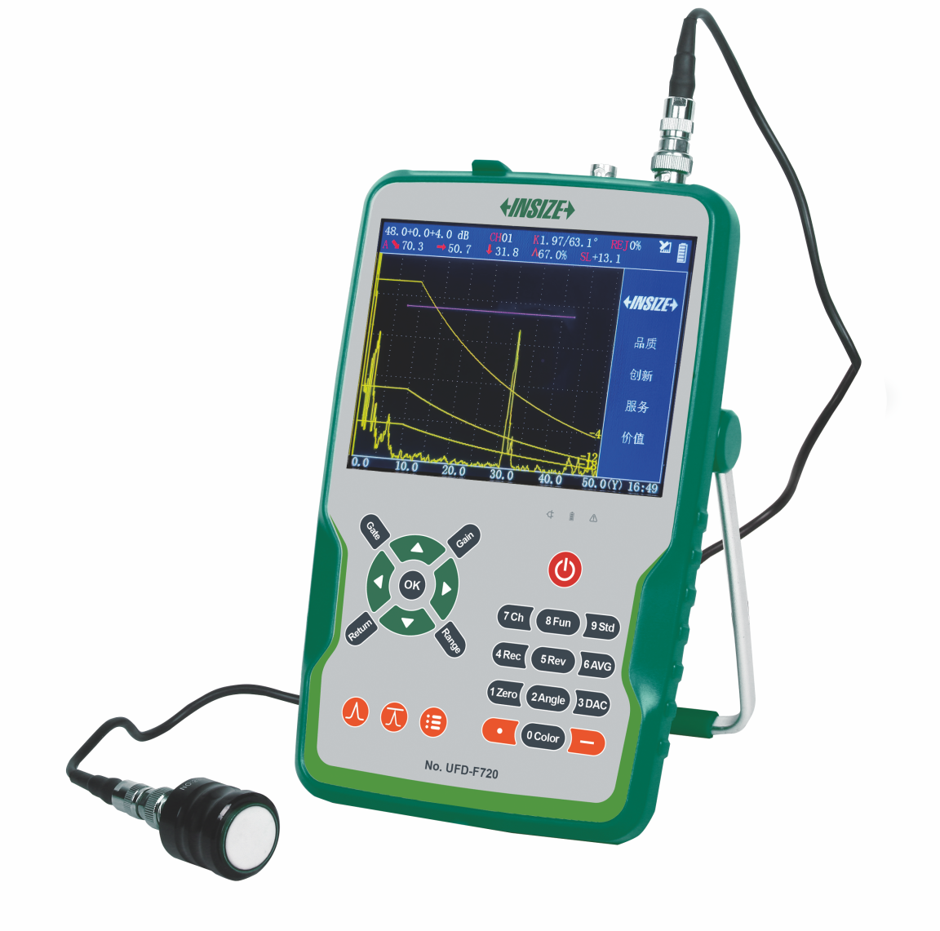
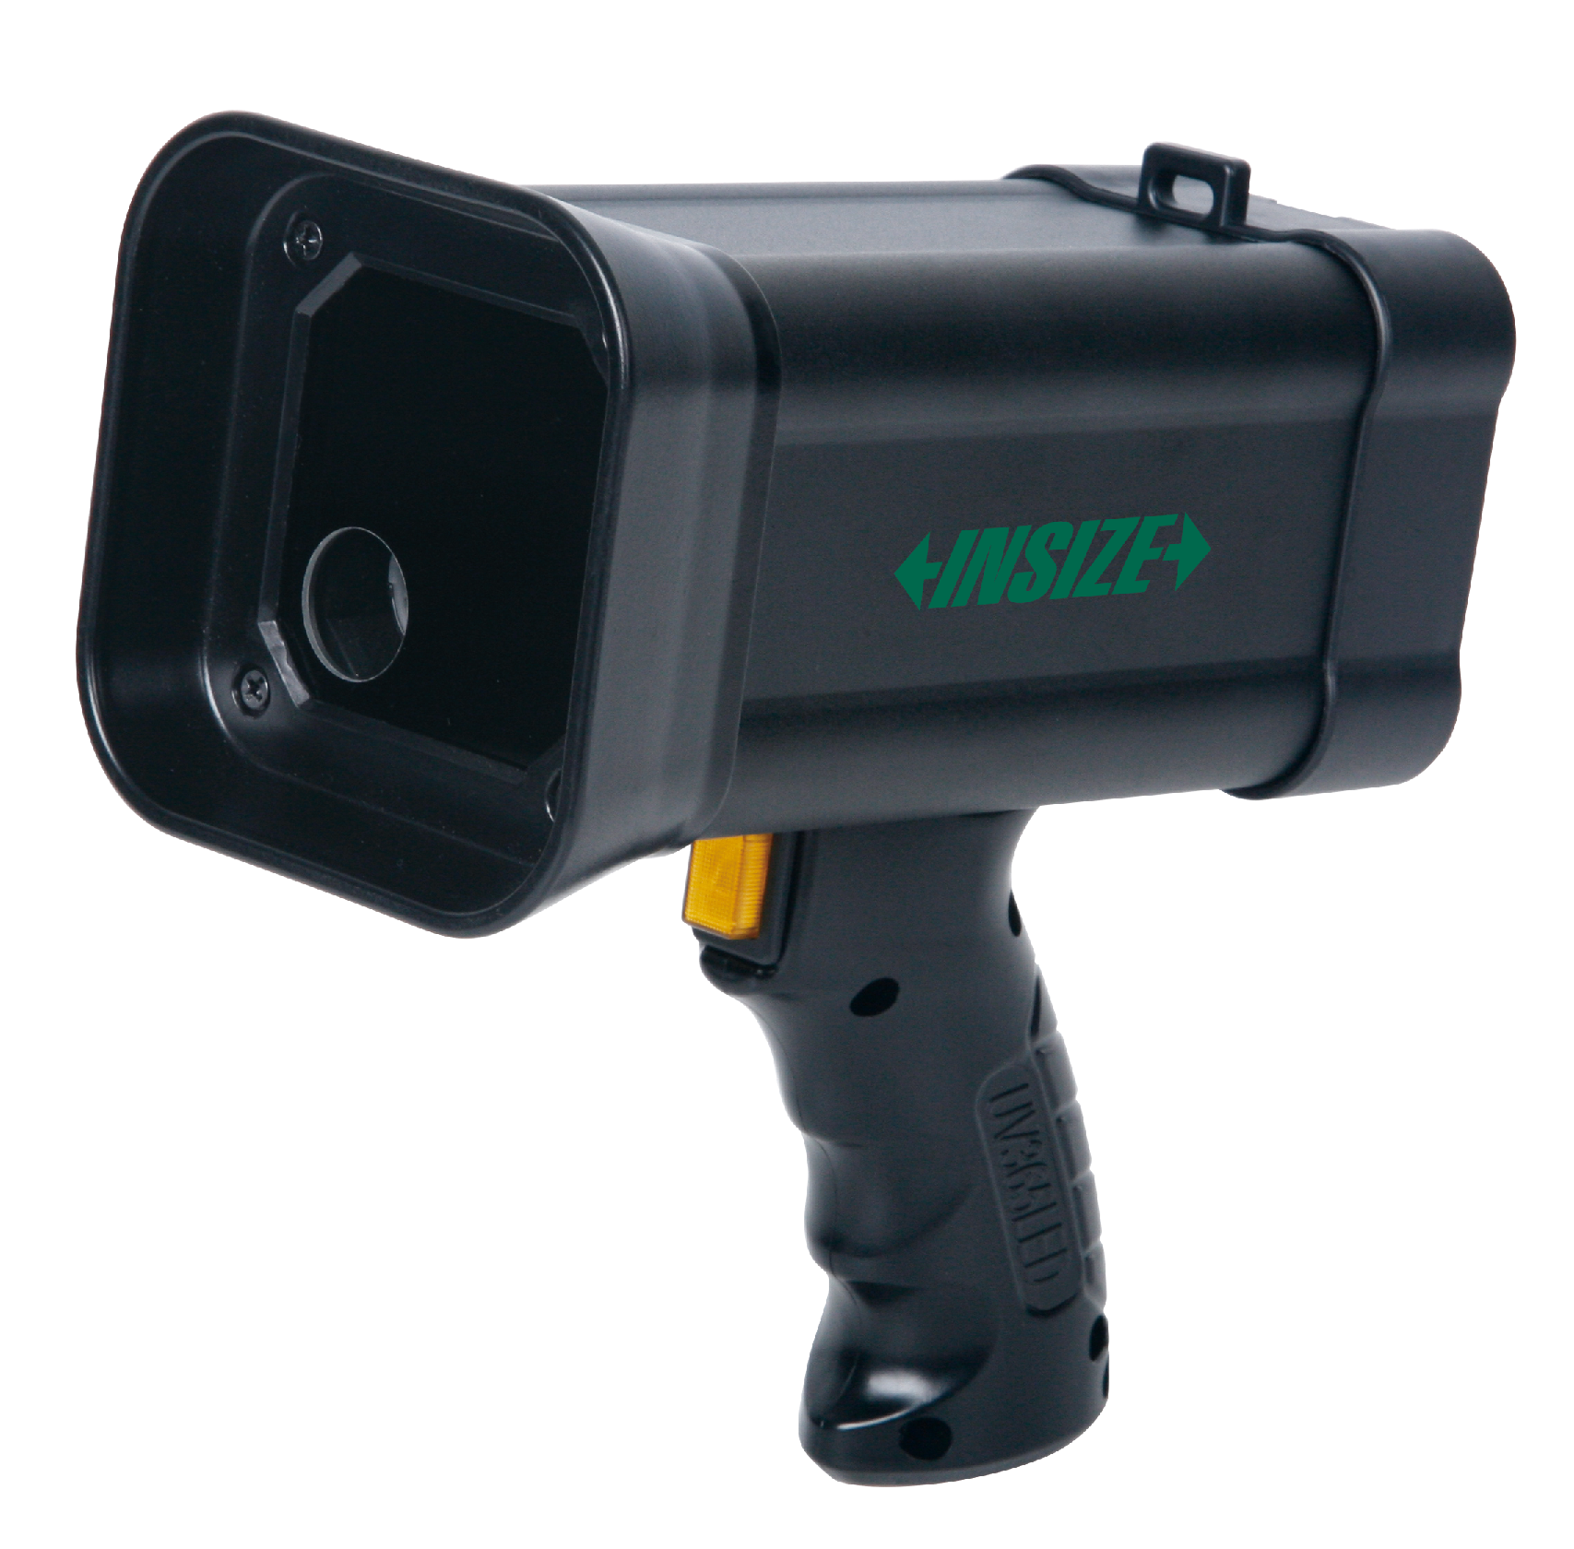

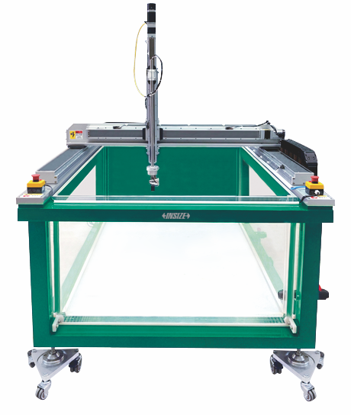
05
Flaw Detection Testing
Magnetic Powder Flaw Detectors
Eddy Current Flaw Detectors
Ultrasonic Flaw Detectors
UV/White Light Flaw Detection Lights
Ultrasonic Water Immersion Detection Systems
Fluorescent Penetrant Fluids

Slide 10
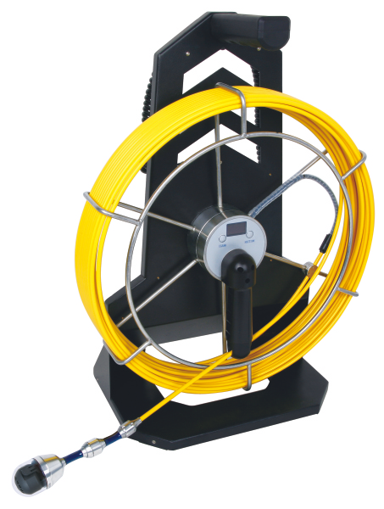
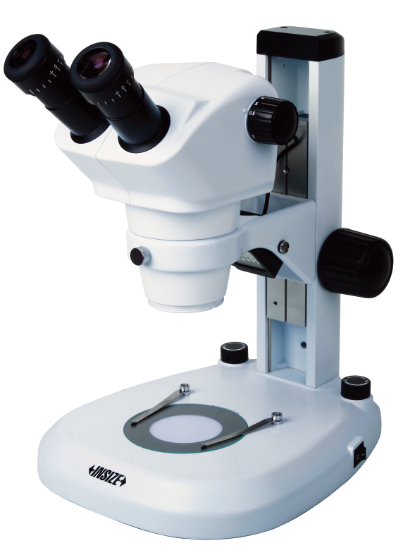
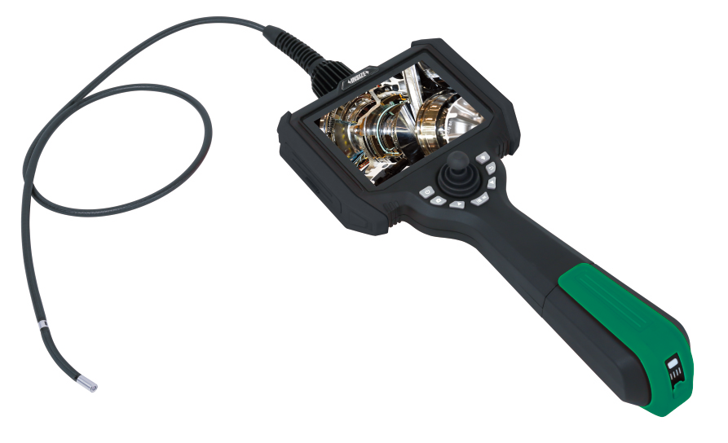
06
Surface Inspection
Videoscopes
Multipurpose Videoscopes
Zoom Stereo Microscopes

Slide 11
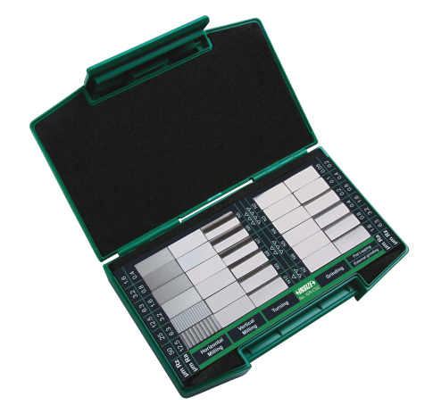
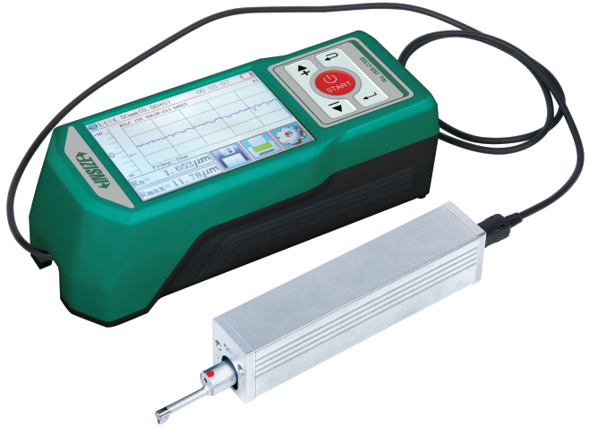


07
Roughness Measurement
Surface Roughness Specimen Sets
Roughness Testers
White Light Interference Measuring Microscopes
Roughness Measuring Machines

Slide 12






08
Hardness Testing (P1)
Brinell Hardness Testers
Vickers Hardness Testers
Rockwell Hardness Testers
Leeb Hardness Testers
Aluminum Hardness Testers
Ultrasonic Hardness Testers

Slide 13






08
Hardness Testing (P2)
Digital Magnetic Rockwell
HardnessTesters
Magnetic Brinell Hardness
Testers
Magnetic Brinell And Rockwell
Hardness Testers
Portable Brinell And Rockwell
Hardness Testers
Hydraulic Brinell Hardness
Testers
Chain Type Hydraulic Brinell
Hardness Testers

Slide 14






09
Metallographic Inspection
Automatic Precision Cutting Machines
Mounting Presses
Automatic Grinders And Polishers
Metallurgical Microscopes
Metallurgical Microscopes
Metallurgical Analysis Software And Cameras

Slide 15



10
Coating/Plating Thickness Measurement
XRF Plating Thickness Instruments
Coating/Film Thickness Measurement Systems
Coating Thickness Gauges

Slide 16



11
Reliability Testing
Temperature And Humidity Chambers
Thermal Shock Test Chambers
Salt Spray Test Chambers

Slide 17






12
Working Condition Inspection
Gas Detectors
Industrial Acoustic Imagers
Holiday Detectors
Infrared Thermal Imaging Cameras
Infrared Thermometers
Bimetallic Thermometers

